Slide 1

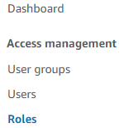
Create a Service role for your Elastic Bean Stalk service
Select Roles

Slide 2
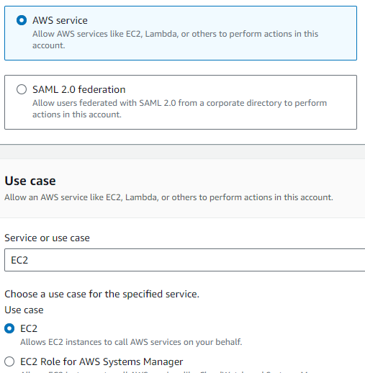

Slide 3
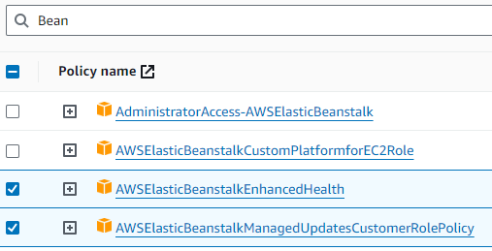
For the Permissions for the role add:

Slide 4
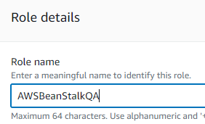

Type a name for the new Role and then click the Create role button.

Slide 5
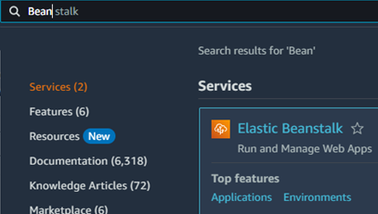

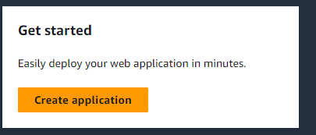
Create your BeanStalk application to upload your app
Type a name for your app (any name you like)

Slide 6
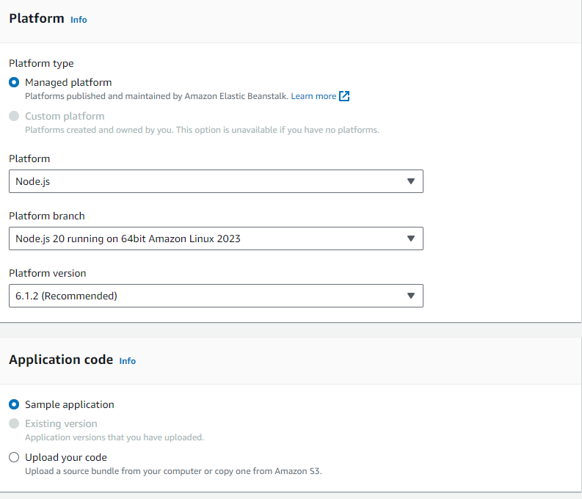


Select Node.js for your platform for a sample app and then click the Next button

Slide 7
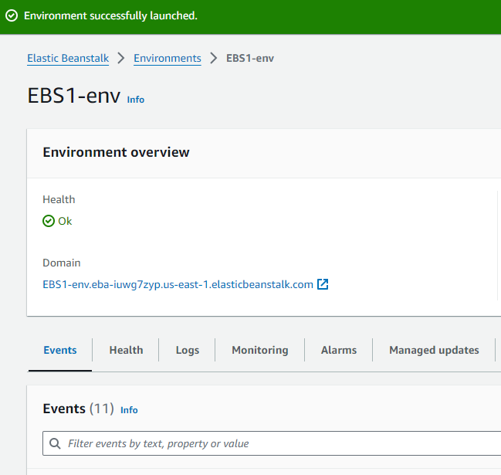
Click

Slide 8
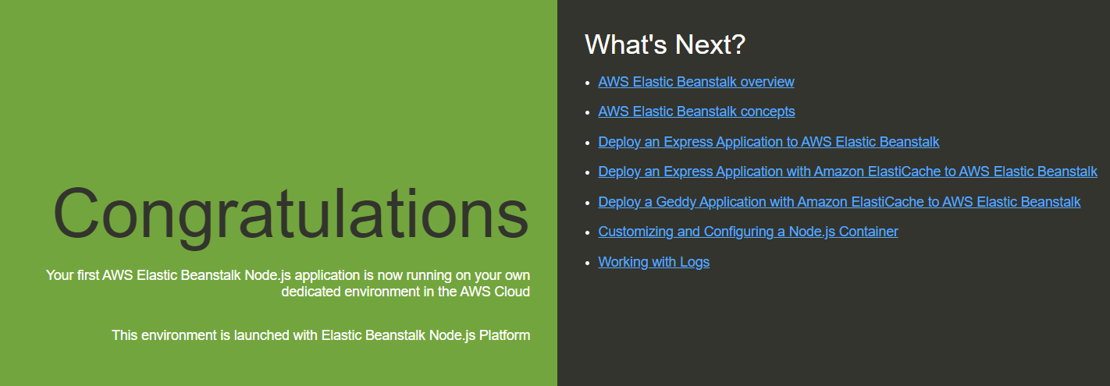

Deploy the sample NodeJS app using the AWS Elastic Beanstalk
Then start

Slide 9
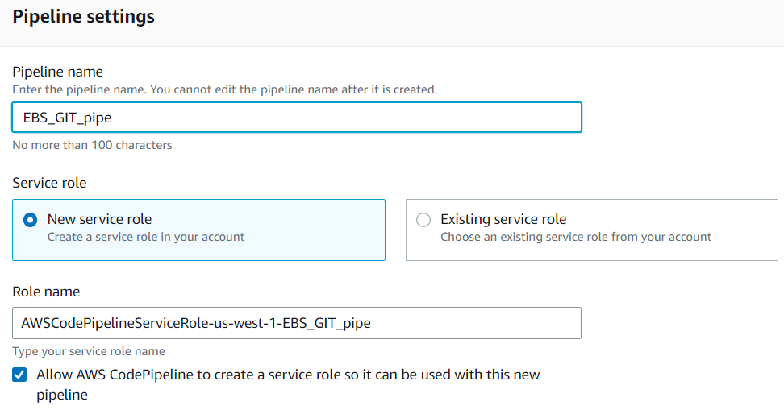

Slide 10
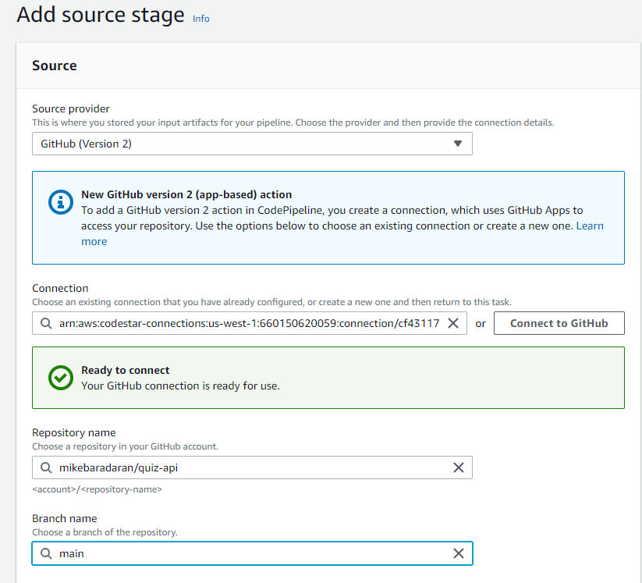

Slide 11
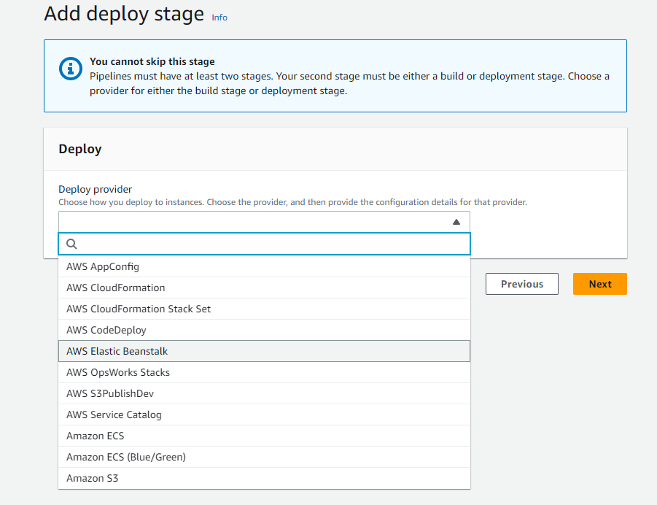

Slide 12
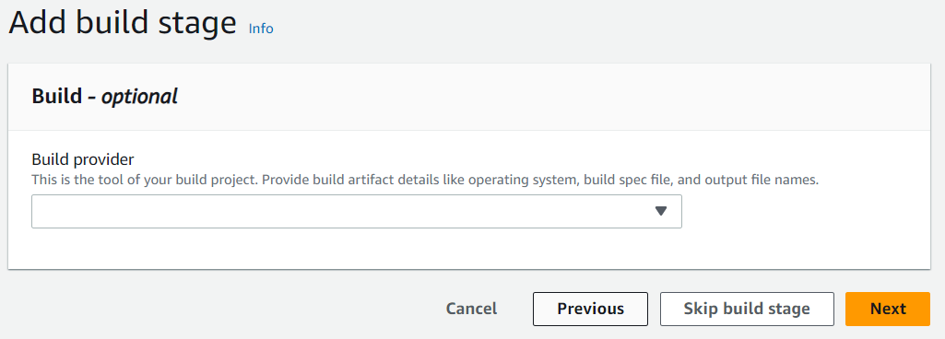


Slide 13
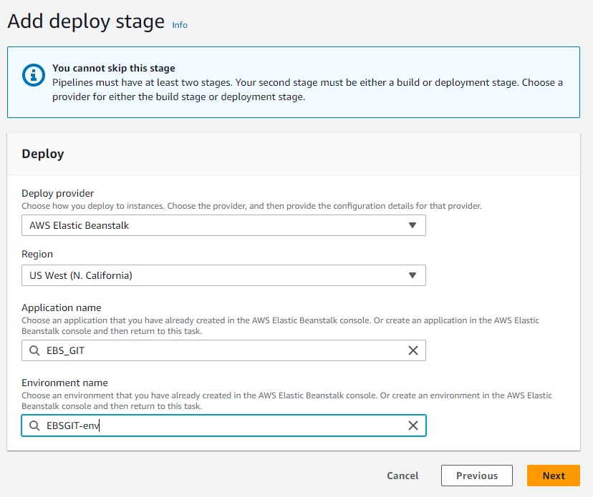

Slide 14
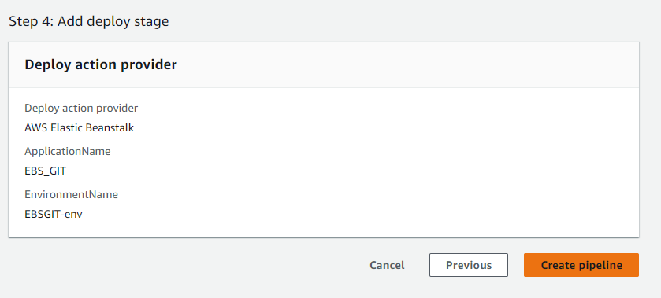

Slide 15
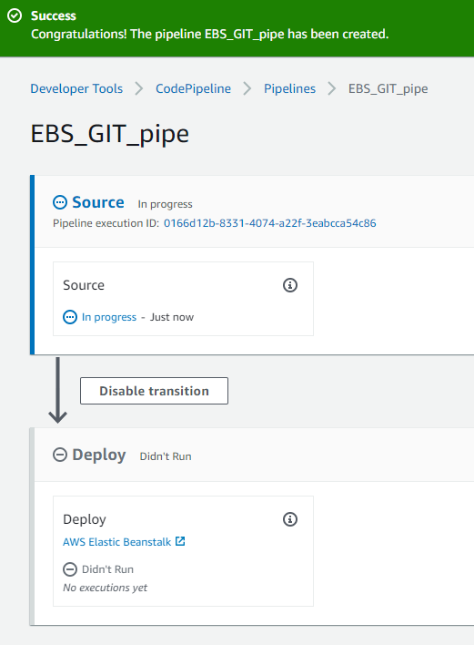
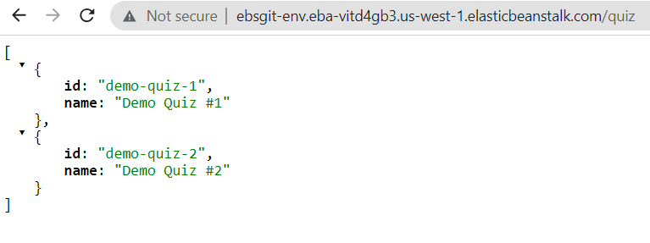
After a few minutes click here and click on your EBS URL

Slide 16
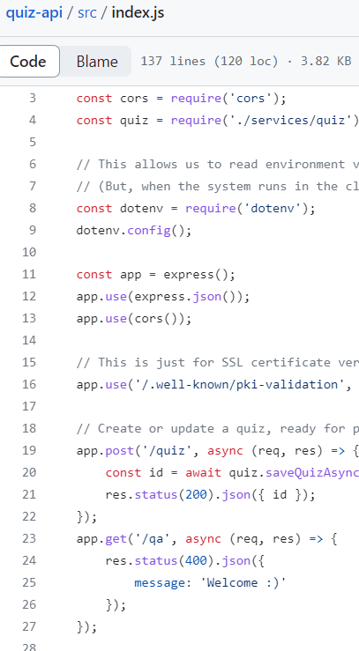

Make changes in GitHub

